Slide 1

AWS ELASTIC BEANSTALK FOR APPLICATION DEPLOYMENT
P. Trisha (2210030338)
Under the esteemed guidance of
Ms. P. Sree Lakshmi
Assistant Professor,
Department of Computer Science and Engineering

Slide 2
Project Overview
Problem: Manual application deployment is complex, time-consuming, and error-prone.
Objective: Simplify and automate app deployment using AWS Elastic Beanstalk.
Real-World Relevance: Enables fast, scalable, and cost-effective cloud deployments with minimal infrastructure management.

Slide 3
Services Used
Amazon EC2
Launches and manages the virtual servers (instances) to run the application code.
Amazon S3
Stores static assets like images, media, and backups.
Amazon RDS
Manages scalable and secure databases (e.g., MySQL, PostgreSQL).
Elastic Beanstalk
Automates application deployment, load balancing, and monitoring.
Amazon CloudWatch
Monitors application health and performance metrics.

Slide 4
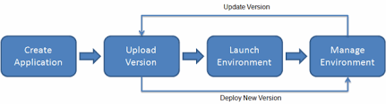
Flow Diagram
Architecture
AWS services communicate via secure, stateless API calls managed by Elastic Beanstalk, ensuring seamless integration between EC2, RDS, S3, and CloudWatch.
Tools used: AWS Management Console,CLI

Slide 5
Implementation Process
Open Elastic Beanstalk in AWS Console
Click "Create Application"
Choose platform (e.g., Python, Node.js)
Upload application .zip file
Configure environment settings
Enable or connect to Amazon RDS (optional)
Upload static files to Amazon S3 (if needed)
Launch the environment
Monitor app via Elastic Beanstalk Dashboard and CloudWatch

Slide 6
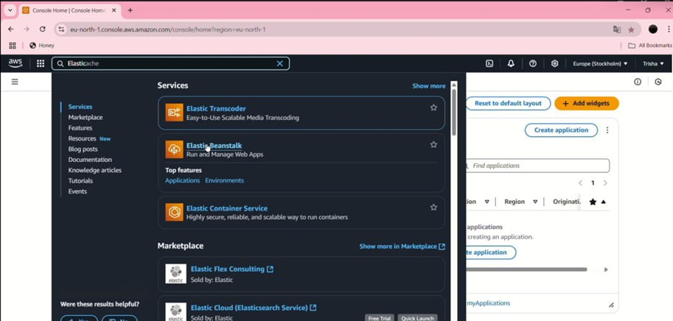
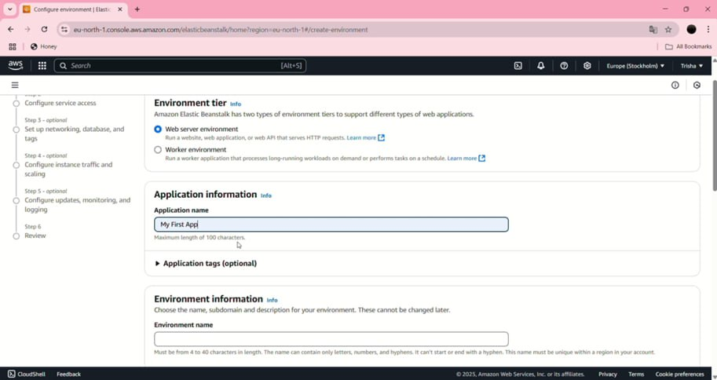

Slide 7
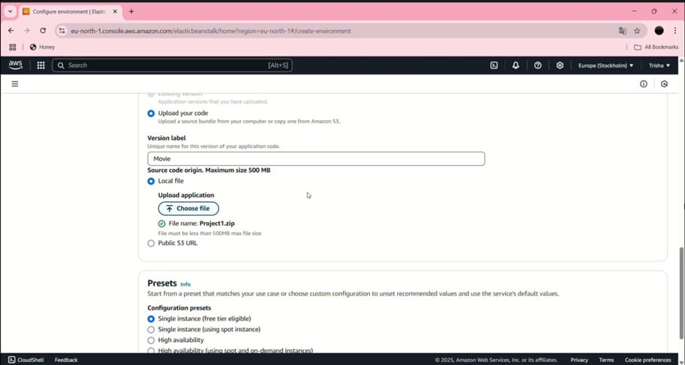
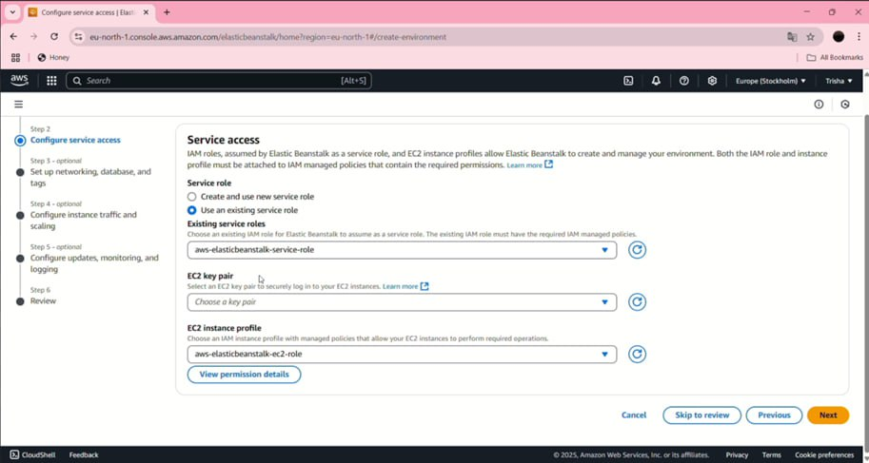

Slide 8
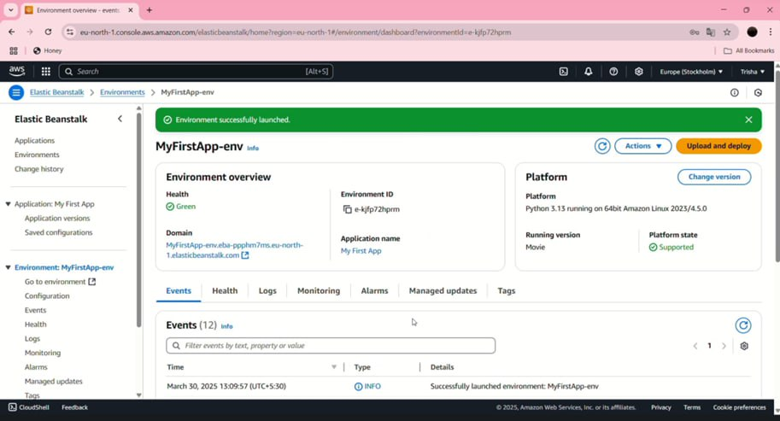

Slide 9
Key Features and Functionality
One-click Deployment using AWS Elastic Beanstalk
Auto-Scaling & Load Balancing for high availability
Amazon S3 for storing static assets
Amazon RDS for backend database integration
CloudWatch for real-time monitoring & logs

Slide 10
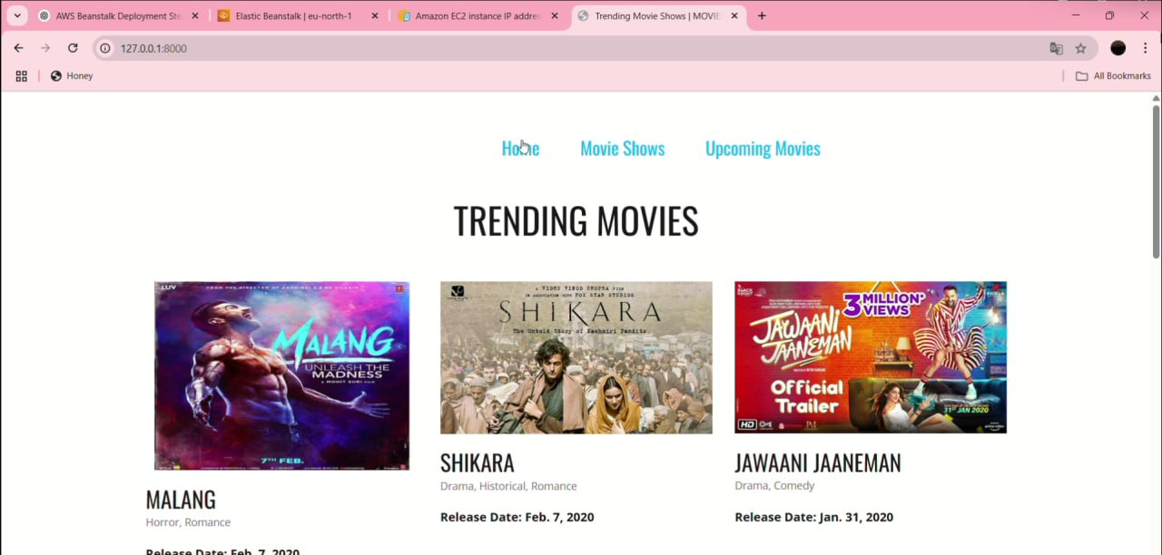

Results and Outputs

Slide 11
Challenges and Solutions
Challenge: Environment configuration mismatches Solution: Used Elastic Beanstalk presets and reviewed platform settings
Challenge: RDS connection failure Solution: Added DB credentials as environment variables and updated security groups
Challenge: Application not deploying correctly Solution: Checked EB logs and resolved errors shown in CloudWatch

Slide 12
Tools/Strategies for Debugging:
CloudWatch Logs: Monitored real-time logs for errors and performance bottlenecks.
Elastic Beanstalk Health Dashboard: Quickly identified environment issues.
AWS CLI & Console: Troubleshot issues related to deployment and database connections

Slide 13
Learnings & Takeaways
Gained hands-on experience with Elastic Beanstalk, EC2, S3, RDS, and IAM
Learned deployment, monitoring, and environment configuration
Improved project planning and problem-solving skills
Explored AWS resources; planning for Cloud Practitioner certification

Slide 14
Future Scope
Add CI/CD pipeline for automated deployments
Enable real-time monitoring and alerts using CloudWatch
Integrate custom domains and SSL for secure access
Optimize cost using EC2 Spot Instances and right-sizing
Implement auto-scaling policies based on traffic patterns
Explore containerization with Docker and ECS

Slide 15
References
[1] AWS Elastic Beanstalk Overview:
https://aws.amazon.com/elasticbeanstalk
[2] Overview of Deployment Options on AWS: https://docs.aws.amazon.com/whitepapers/latest/overview-deployment-options/aws elastic-beanstalk.html
[3] Introduction to DevOps on AWS: AWS Elastic Beanstalk. https://docs.aws.amazon.com/whitepapers/latest/introduction-devops-aws/aws elasticbeanstalk.html
[4] AWS Elastic Beanstalk Supported Platforms. https://docs.aws.amazon.com/elasticbeanstalk/latest/dg/concepts.platforms.html

Slide 16
THANK YOU

